Slide 1
IDENTIFICATION OF BACTERIA
Dr. Priyanka Mane
MBBS MD PhD
Assistant Professor

Slide 2
CULTURE IDENTIFICATION
Identification of bacteria from culture is made either by:
Conventional biochemical tests or
Automated identification systems.

Slide 3
Biochemical Identification
Based on the type of colony morphology, Gram- staining appearance - appropriate biochemical tests are employed.
Initially - catalase and oxidase tests are done.

Slide 4
Biochemical Identification (Cont..)
For gram-negative bacilli - Common biochemical tests done routinely – ‘ICUT’
  Indole test
  Citrate utilization test
  Urea hydrolysis test
  Triple sugar iron test (TSI).

Slide 5
Biochemical Identification (Cont..)
For gram-positive cocci:
  Coagulase test (for Staphylococcus aureus)
  CAMP (Christie-Atkins-Munch-Petersen) test - group B Streptococcus.
  Bile esculin hydrolysis test (for Enterococcus)
  Inulin fermentation (for pneumococcus)
  Bile solubility test (for pneumococcus)

Slide 6
Biochemical Identification (Cont..)
Antimicrobial susceptibility tests - for bacterial identification:
  Optochin susceptibility test - pneumococcus (sensitive)
  Bacitracin susceptibility test - differentiate group A (sensitive) from group B (resistant) Streptococcus.

Slide 7
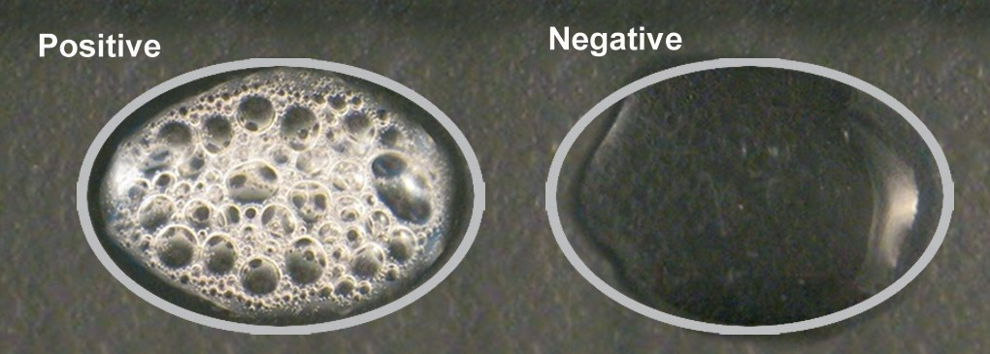
Catalase Test
When a drop of hydrogen peroxide (3% H2O2 ) - added to a colony of any catalase producing bacteria - effervescence or bubbles appear due to breakdown of H2O2 by catalase to produce oxygen.
Differentiate - Staphylococcus (positive) from Streptococcus (negative).

Slide 8
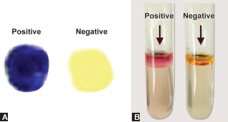
Oxidase Tests
Detects the presence of cytochrome oxidase enzyme in bacteria which catalyses the oxidation of reduced cytochrome by atmospheric oxygen.
Oxidase positive (deep purple)- Pseudomonas , Vibrio, Neisseria, Bacillus etc.
Oxidase negative (no colour change) - members of family Enterobacteriaceae, Acinetobacter, etc.

Slide 9
Indole Test
Detects the ability of certain bacteria to produce enzyme tryptophanase - breaks down amino acid tryptophan present in the medium into indole.
Indole positive - Red colored ring is formed near the surface of the broth. Eg: Escherichia coli, Proteus vulgaris, Vibrio cholerae, etc.

Slide 10
Indole Test
Indole negative - Yellow colored ring is formed near the surface of the broth, e.g. Klebsiella pneumoniae, Proteus mirabilis, Pseudomonas, Salmonella, etc.

Slide 11
Citrate Utilization Test
Detects the ability of a few bacteria to utilize citrate as the sole source of carbon for their growth, with production of alkaline metabolic products.
Performed on Simmon’s citrate medium - Citrate utilizing bacteria produce growth and a color change, i.e. original green color changes to blue

Slide 12
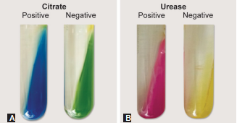
Citrate Utilization Test (Cont..)
Citrate test - positive for Klebsiella pneumoniae, Citrobacter, Enterobacter, etc.
Negative for Escherichia coli, Shigella, etc.

Slide 13
Urea Hydrolysis Test
Urease producing bacteria - split urea present in the medium to produce ammonia - makes the medium alkaline.
Test - done on Christensen’s urea medium - contains phenol red indicator - changes to pink color in alkaline medium

Slide 14
Urea Hydrolysis Test (Cont..)
Urease test is positive for - Klebsiella pneumoniae, Proteus species, Helicobacter pylori, Brucella, etc.
Urease test is negative for - Escherichia coli, Shigella, Salmonella, etc.

Slide 15
Triple Sugar Iron (TSI) Agar Test
Contains three sugars - glucose, sucrose and lactose in the ratio of 1:10:10 parts.
Uninoculated TSI medium - red in color
After inoculation - the medium is incubated at 37°C for 18–24 hours.

Slide 16
Triple Sugar Iron (TSI) Agar Test (Cont..)
Interpretation: detects three properties of bacteria, such as
Fermentation of sugars to produce acid
Fermentation of sugars to produce gas
Production of H2 S.

Slide 17
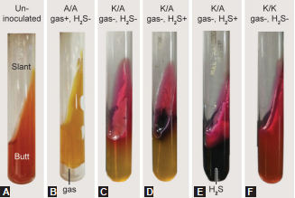
Triple Sugar Iron (TSI) Agar Test (Cont..)

Slide 18
Triple Sugar Iron (TSI) Agar Test (Cont..)
Reactions in TSI | Examples
Acidic slant/acidic butt | ≥2 sugars fermented - (1) glucose, (2) lactose or/and sucrose
A/A, gas produced, no H2S (Fig B) | Escherichia coli, Klebsiella pneumoniae
Alkaline slant/acidic butt | Only glucose-fermenter group
K/A, no gas, no H2S (Fig C) | Shigella
K/A, no gas, H2S produced (small amount) (Fig D) | Salmonella Typhi
K/A, no gas, H2S produced (abundant) (Fig E) | Proteus vulgaris
K/A, gas produced, H2S produced (abundant) | Salmonella Paratyphi B
K/A, gas produced, no H2S | Salmonella Paratyphi A
Alkaline slant/alkaline butt | Non-fermenters group
K/K, no gas, no H2S (Fig F) | Pseudomonas, Acinetobacter

Slide 19
ANTIMICROBIAL SUSCEPTIBILITY TEST

Slide 20
ANTIMICROBIAL SUSCEPTIBILITY TEST
Bacteria exhibit great strain variations in susceptibility to antimicrobial agents - AST plays a vital role to guide the clinician for tailoring the empirical antibiotic therapy to pathogen-directed therapy.
Performed only for pathogenic bacteria isolated from the specimen, and not for the commensal bacteria.
Classified into phenotypic and genotypic methods.

Slide 21
ANTIMICROBIAL SUSCEPTIBILITY TEST (Cont..)
Phenotypic methods -
Disk Diffusion Method- e.g. Kirby–Bauer’s disk diffusion (DD) test
Dilution tests: Broth Dilution and agar dilution Method
Epsilometer or E-test
Automated AST-e.g. Vitek, Phoenix and Microscan systems
Genotypic methods -
PCR detecting drug resistant genes

Slide 22
Procedure (Colony disk diffusion)
Antibiotic disks - impregnated on to a suitable medium lawn cultured with the test isolate.
Antibiotic disks:
Antibiotic disks - commercially or prepared in-house.
Sterile filter paper disks - 6 mm diameter are impregnated with standard quantity of antibiotic solution.

Slide 23
Procedure (Colony disk diffusion) (Cont..)
Medium:
Mueller–Hinton agar (MHA) - standard medium used for AST.
S. pyogenes and S. pneumoniae - Mueller–Hinton blood agar (MHBA) containing 5% of sheep blood is used.

Slide 24
Procedure (Colony disk diffusion) (Cont..)
Inoculum preparation:
Directly suspending the colony in the normal saline or
Inoculating into suitable broth and incubating at 37°C for 2 hours
Turbidity:
Adjusted to 0.5 McFarland opacity standard - equivalent to approximately 1.5 × 10 ⁸cfu/mL of bacteria.

Slide 25
Procedure (Colony disk diffusion) (Cont..)
Lawn culture:
Broth - inoculated on to the medium by spreading with sterile swabs
Disks impregnation:
Disks - placed atleast 24 mm (center to center) apart on the MHA plate.
Maximum up to 6 disks can be applied on a 100 mm plate.

Slide 26
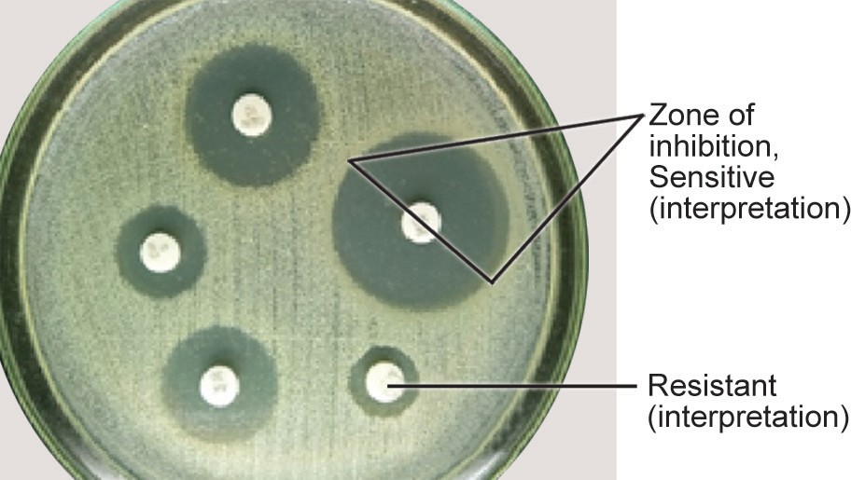
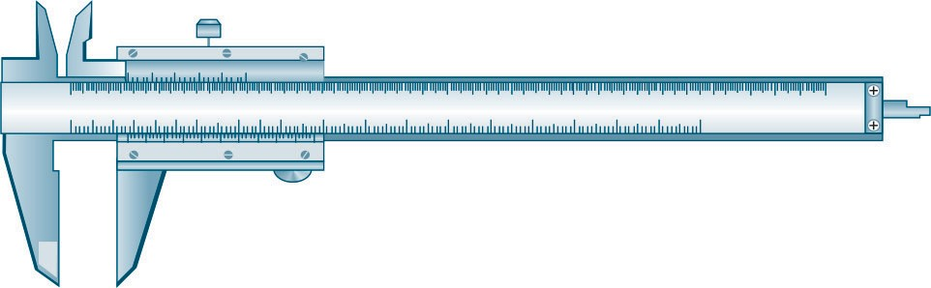
Interpretation
Susceptibility to the drug - determined by the zone of inhibition of bacterial growth around the disk - measured by Vernier caliper.

Slide 27
Commonly used disk concentrations and interpretation of disk diffusion test (as per CLSI 2020 guideline)
Antimicrobial agents | Disk strength (µg) | Zone diameter break points (mm) |  |  | MIC breakpoints (µg/ml)
 |  | Sensitive | Intermediate | Resistant | Sensitive | Intermediate | Resistant
Ceftazidime | 30 | ≥ 21 | 18-20 | ≤ 17 | ≤ 4 | 8 | ≥ 16
Ceftriaxone | 30 | ≥ 23 | 20-22 | ≤ 19 | ≤ 1 | 2 | ≥ 4
Ciprofloxacin | 5 | ≥ 26 | 22-25 | ≤ 21 | ≤ 0.25 | 0.5 | ≥ 1
Cefoxitin (S.aureus) | 30 | ≥ 22 | - | ≤ 21 | ≤ 4 | - | ≥ 8
Levofloxacin (S.aureus) | 5 | ≥ 19 | 16 18 | ≤ 15 | ≤ 1 | 2 | ≥ 4
Cotrimoxazole (S.aureus) | 1.25/23.75 | ≥ 16 | 11-15 | ≤ 10 | ≤ 2 | - | ≥ 4

Slide 28
Direct Disk Diffusion Test
Performed when results are required urgently and single pathogenic bacterium is suspected in the specimen (for positively flagged blood culture bottle, sterile fluid or urine).
Specimen - directly inoculated - on to the surface of an agar plate and the antibiotic disks are applied.

Slide 29
Direct Disk Diffusion Test (Cont..)
Results of the direct-DD test - verified by performing AST from the isolate separately.

Slide 30
Dilution Tests
Antimicrobial agent - serially diluted - each dilution is tested with the test organism for ASTand the MIC is calculated.
MIC (minimum inhibitory concentration) - lowest concentration of an antimicrobial agent that will inhibit the visible growth of microorganism after overnight incubation.

Slide 31
Dilution Tests (Cont..)
Depending upon whether the dilutions of the antimicrobial agent are made in agar or broth, there are two types of dilution tests.
  Broth Dilution Method
  Agar Dilution Method

Slide 32
Broth Dilution Method
Two types:
  Macro broth dilution (performed in tubes)
  Micro broth dilution (performed in microtiter plate).

Slide 33
Broth Dilution Method (Cont..)
Serial dilutions of the antimicrobial agent in Mueller Hinton broth are taken in tubes - each tube is inoculated with a fixed amount of suspension of the test organism.
MIC - determined by - lowest concentration of the drug at which there is no visible growth, i.e. broth appears clear

Slide 34
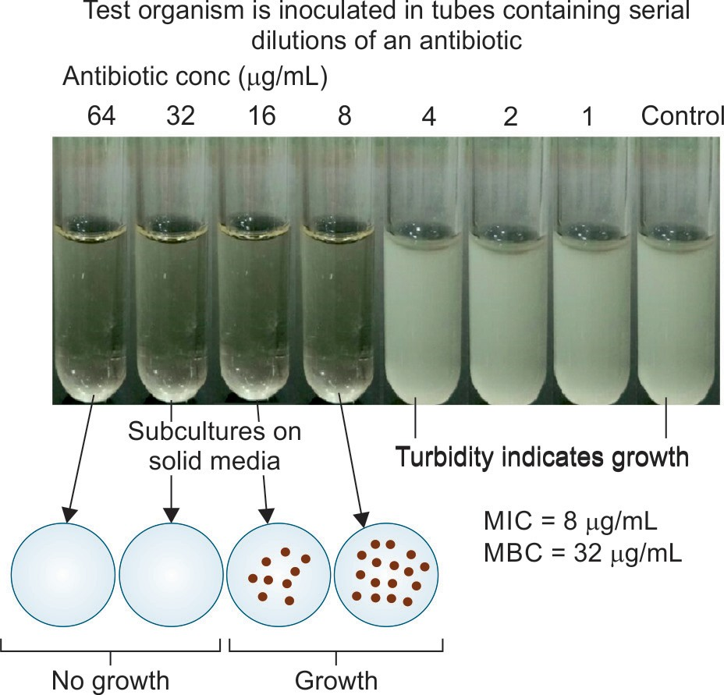
Broth Dilution Method (Cont..)

Slide 35
Broth Dilution Method (Cont..)
Minimum bactericidal concentration (MBC) - obtained by subculturing from each tube (showing no growth) onto a nutrient agar plate without any antimicrobial agent.
Tube containing the lowest concentration of the drug that fails to show growth, on subculture, is the MBC of the drug for that test strain.

Slide 36
Agar Dilution Method
Serial dilutions of the drug - prepared in molten agar and poured into petri dishes.
Test strain is spot inoculated.
Advantage:
Several strains can be tested at the same time by using the same plate
Directly measures the MBC

Slide 37
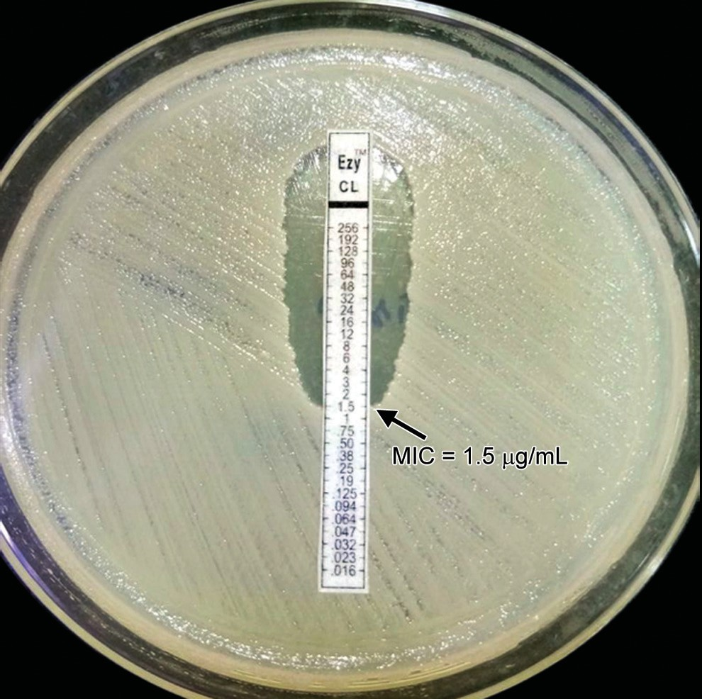
Epsilometer or E-test
Uses an absorbent strip containing predefined gradient (serial dilution) of antibiotic concentration immobilized along its length.
Applied to a lawn inoculum of a bacterium.
Antibiotic concentration at which the ellipse edge intersects the strip -MIC value.

Slide 38
Automated Antimicrobial Susceptibility Tests
VITEK 2 identification and antimicrobial sensitivity system
Phoenix System (Becton Dickinson)
Micro Scan Walk Away system.

Slide 39
VITEK 2 Automated System for AST
Principle - microbroth dilution.
Uses reagent card containing 64 wells - contain doubling dilution of antimicrobial agents. The
Organism suspension - added to the wells (Figure 3.3.23 and Table 3.3.7)
Cards are incubated in the system at 35.5 ±1°C.

Slide 40
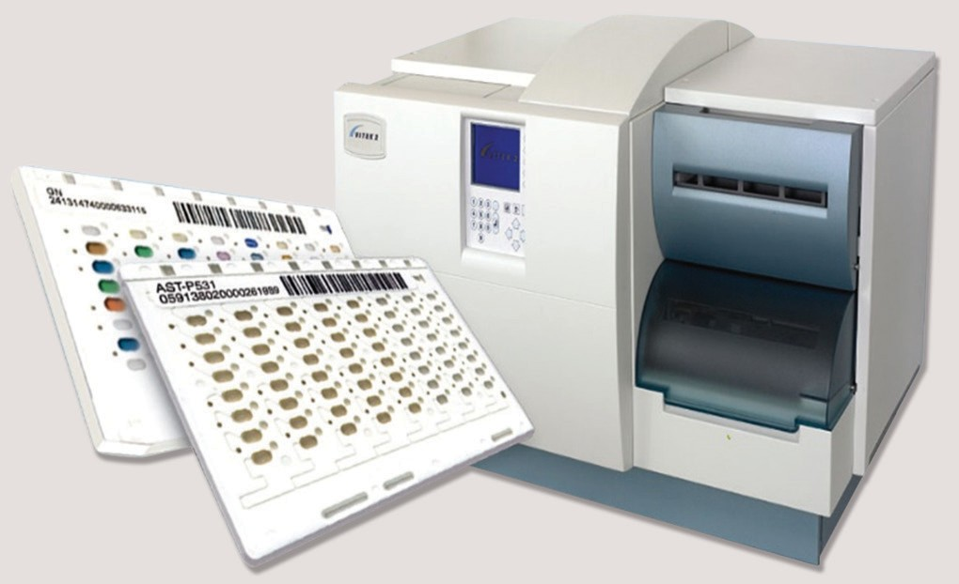
VITEK 2 Automated System for AST (Cont..)
Reading - taken once in every 15 minutes.
Results - available within 8-10 hours for gram negative bacilli and 16-18 hours for gram-positive cocci.

Slide 41
Role of MIC
To select the most appropriate antibiotic - Lower is the MIC, better is the therapeutic efficacy
Better guided - calculating the therapeutic index - ratio of susceptibility breakpoint divided by the MIC of the test isolate.
MIC-guided therapy

Slide 42
Interpretation of AST
Terminology | Definition
Susceptible (S) | Antibiotic is clinically effective when used in standard therapeutic dose.
Intermediate (I) | Antibiotic is not clinically effective when used in standard dose; but may be active when used in increased dose.
Susceptible dose dependent (SDD) | Antibiotic will be clinically active only if given in increased dose.
Resistant (R) | Antibiotic is NOT clinically effective when used in either standard dose or increased dose.

Slide 43
Choice of Antibiotics to be Included in Panel
Clinically indicated
Organism isolated and local resistance pattern
Intrinsic resistance - excluded from the panel
Antimicrobial agent - oral and parenteral - included
Locally available antibiotic
Site of action - tested which are active in the site.
Predicting susceptibility

Slide 44
Selective or Cascade Reporting
Clinical microbiology laboratory - test for the full antibiotic panel, but - should report only in a selective manner.
If all antimicrobial agents are susceptible - only first-line agents are reported - second-line and restricted antimicrobials are supressed.

Slide 45
Selective or Cascade Reporting (Cont..)
Enterobacteriaceae | Antimicrobial agent used in VITEK
First line | Ampicillin
First line | Amoxicillin- clavulanic acid
First line | Ciprofloxacin
Second line | Cefoperazone-sulbactam
Second line | Piperacillin- tazobactam
Restricted | Meropenem
Restricted | Colistin

Slide 46
THANK YOU

