Slide 1
THANATOLOGY

Slide 2
THANATOLOGY :-
“ SCIENCE THAT DEALS WITH DEATH IN ALL ITS ASPECTS.”

Slide 3
DUTIES OF DOCTOR RELATING TO DEATH
Prevent the death.
Pronounce the person dead.
Ascertain the cause of death, time of death, etc.

Slide 4
DEFINITIONS OF DEATH
LEGAL :- according to Black’s law dictionary –
“cessation of life or ceasing to exist.”
MEDICAL :- “Total stoppage of circulation with consequent cessation of vital functions.”
MEDICO – LEGAL :- “Death is permanent and irreversible cessation of the three interlinked systems of the body (tripod of life) – nervous, circulatory and respiratory systems.”

Slide 5
IMPORTANCE OF DEATH
MEDICO – LEGAL ASPECTS.
TRANPLANTATION OF TISSUE OR ORGANS.

Slide 6
Clinical or systemic deaths are known as somatic deaths.
Stoppage of oxygen supply.
Death of cells of tissues or organs.
Cellular or molecular death

Slide 7
Brain cells :- within 5 minutes after somatic death.
Muscles :- death starts by end of 1st hour after somatic death.
Blood cells and cornea :- 6 hours.
Skin – 24 hours
Bone – 48 hours
Blood vessels – 72 hours
Organs like liver, kidney and heart die early. Fibrous tissue dies late.

Slide 8
BRAIN DEATH
Cortical death.
Brainstem death
Both Cortical and Brainstem death.
Called as “LIVING CADEVERS.”

Slide 9
BRAINSTEM DEATH
Diagnosed clinically by :- Harvard criteria
Absence of corneal and cough reflex.
Dilated and fixed pupil, not reactive to light.
Absence of vestibulo – ocular reflex.
Absence of cranial motor responses to painful stimuli.
No movements, unresponsivity.
Test withdrawal of respiratory aid for 30 seconds showing no revival.
Isoelectric EEG.

Slide 10
PRECAUTIONS
To avoid misdiagnosis :-
Rule out hypothermia – temperature above 35 degree celsius.
Diagnosed by team of doctors – neurophysician, anaesthesist, experienced ICU Doctor.
Examined by the team atleast twice with a reasonable period of gap in between.
None of the team member should have any interest in transplantation of organ, removed from the subject.

Slide 11
SUSPENDED ANIMATION
Also called APPARENT DEATH.
Vital functions are reduced to a minimum.
Reversible – death like state.
Can occur in :- drowning, electrocution, extreme cold (hypothermia) – involuntary.
Practiced by YOGI’S – voluntary.

Slide 12
NATURAL DEATH :-
“Death due to any natural disease, pathological condition, old age, debility or devitalisation – where death is not intended, attempted and is not accidental.”
SUDDEN DEATH :-
“Death not known to have been caused by any trauma, poisoning or violent asphyxia, and where death occurs all of a sudden or within 24 hours of onset of terminal symptoms.”

Slide 13
CAUSES OF SUDDEN DEATH
CARDIOVASCULAR :- 45%
RESPIRATORY :- 20 %
NERVOUS :- 15%
GASTRO – INTESTINAL :- 6%
GENITO – URINARY :- 4%
MISCELLANEOUS :- 10%

Slide 14
MODES OF DEATH
Process of death can be initiated by failure of any one of the 3 vital systems of life :-
Failure of nervous system = COMA.
Failure of circulatory system = SYNCOPE.
Failure of respiratory system = ASPHYXIA.

Slide 15
COMA
Loss of consciousness :-
Deep coma = full unconsciousness without any response to stimulus. All reflexes are lost.
Partial coma = partially conscious, responds to deep and painful stimuli. Reflexes may be sluggish, normal or even brisk at times.

Slide 16
CAUSES OF COMA
Cerebral compression – from head injury.
Infections like encephlitis, meningitis, abscess etc.
Compression caused by new growth.
Metabolic disorders like diabetes, uraemia.
Lack of circulation in brain – embolism or block of carotid or vertebral arteries.
Drugs or poisons – opium, alcohol, CO, CO2, chloroform.
Miscellaneous – epilepsy, heat stroke, hypoxia of any origin.

Slide 17
SYNCOPE
Circulatory collapse
Rapid, weak pulse & reduced BP.
Air hunger, feeling of oppression in chest.
Ringing in the ear and dimness of vision.
Cyanosis, cold skin, sweating.
Vital centres at base of the brain fail.

Slide 18
CAUSES ON SYNCOPE
Pathology of heart.
Vagal inhibition of heart.
Anaemia – sudden blood loss > 1/3rd of total blood volume.
Anoxia.
Cardiac poisons.
Over exercise or exhaustion.

Slide 19
ASPHYXIA
In asphyxia, there is prevention of exchange of air between the atmosphere and the lungs alveoli and there is lack of oxygen supply to the tissues.
Causes :-
Mechanical.
Toxic.
Traumatic.
Pathological.

Slide 20
STAGES OF ASPHYXIA :-
Stage of dyspnoea - CO2 level in blood, respiratory stimulation -> increasing rate and depth of respiration. Increased pulse , BP. Headache and mild cyanosis.
Stage of convulsion – neck veins engorged, marked cyanosis, expiratory effort - more prominent - convulsions.
Stage of respiratory exhaustion – respiratory centre is depressed causing gasping and decreased rate. Muscles are relaxed, reflexes lost or sluggish, deep cyanosis, dilated pupils. Pulse and BP fall. Involuntary passage of stool and urine possible. Failure of vital centres and death.

Slide 21
PATHOGENESIS OF ASPHYXIA
ASPHYXIA
REDUCED O2 AND INCREASED CO2 IN BLOOD.
CAPILLARY DILATATION & LOSS OF TONE
STASIS OF BLOOD
CONGESTION AND OEDEMA OF ORGANS
LOW VENOUS RETURN
DECREASED O2

Slide 22
POST MORTEM CHANGES

Slide 23
INTRODUCTION
Forensic taphonomy = interdisciplinary study and interpretation of post-mortem processes of human remains – changes of a body after death.
These changes help in estimating the approximate time of death.
Also helps to distinguish between death and suspended animation.

Slide 24
SIGNS OF DEATH (in order)
IMMEDIATE (SOMATIC DEATH) :-
Insensibility and loss of voluntary power. :- earliest sign.
Cessation of respiration.
Cessation of circulation.
EARLY (CELLULAR DEATH) :-
Pallor and loss of elasticity of skin.
Changes in the eye.
Primary flaccidity of muscles.
Cooling of the body.
Post mortem lividity,
Rigor mortis.
LATE (DECOMPOSITION AND DECAY) :-
Putrefaction.
Adipocere formation.
Mummification.

Slide 25
CHANGES IN EYES
Loss of corneal reflex.
Opacity of the cornea :- tache noir = 3 - 4 hours. Opacity delayed for 2 hours if eyes are closed after death.
Flaccidity of the eyeball :- eyes are sunken and soft within minutes.
CONDITION | IOP
DURING LIFE | 14 – 25 gm
SOON AFTER DEATH | 12
30 MINS AFTER DEATH | < 3
2 HOURS AFTER DEATH | NIL

Slide 26
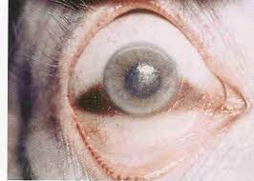

Slide 27
4) Pupils :- dilated initially due to relaxation of iris. Later, constriction is seen with onset of rigor mortis of constrictor muscle and evaporation of fluids.
5) Retinal vessels :- kevorkian sign – fragmentation or segmentation of blood column in retinal vessels – within minutes, persisting for an hour.
6) Chemical changes :- steady rise in potassium levels in vitreous humor up to 100 hours.

Slide 28
ALGOR MORTIS
Also called “cooling of the body” (chill of death).
Initially temperature remains constant for 30 mins – 1 hour – metabolic activity of dying tissues and bacteria.
Internals organs cool by conduction. Body by conduction and convection. Small fraction by evaporation of fluid from skin.
1st hour – no change. 0.4 – 0.6 degree Celsius/hour for next 12 – 16 hours. Cooling becomes slow when temperature is within 4 deg C of environment. Curve of cooling is sigmoid or inverted “s” shaped.

Slide 29
Measured by lab thermometer - 25cm long, ranging from 0 – 50 degree C. Ideal place to record is by inserting 8 – 10 into the rectum for 2 mins.
Roughly approx time of death can be calculated by – normal body temp – rectal temperature/ rate of temperature fall per hour.
Factors affecting rate of cooling :-
Difference in temperature between body and medium.
Build of the cadaver.
Physique
Environment of the body.
Covering on or around the body.

Slide 30
Medico – Legal importance =
To determine the temperature of the body.
To estimate the time since death.
Post mortem caloricity – condition where temperature remains raised for 2 or more hours after death.
Eg = sunstroke, convulsions, tetanus, strychnine, septicaemia, cholera, pontine haemorrhage etc.

Slide 31
POSTMORTEM HYPOSTASIS
Bluish purple or purplish red discolouration of the superficial layers of dermis under the skin of dependent parts of the body after death, due to capillovenous distension.
Also called as postmortem staining, livor mortis, cadaveric lividity, suggilations, vibices, darkening of death etc.
Mechanism = circulation stops – stagnation of blood in vessels – tendency to sink by force of gravity.

Slide 32
Distribution = depends on position of body.
Begins shortly after death.
Dull red patches 1 -2 cm diameter appear in :- 20 – 30 mins.
Confluence in :- 1 – 4 hours.
Primary lividity – maximum :- 6 – 12 hours.
Secondary lividity :- body moved within few hours, patches of lividity disappears and new ones form on dependent parts.
Fixation : 8 -10 hours or more.

Slide 33
Extent and time of appearance of lividity depends upon:-
1) volume of blood in circulation at time of death.
2) length of time blood remains as fluid after death.
Internal hypostasis :- occurs in dependant part of internal organs.
Changes in postmortem lividity occurs when putrefaction sets in. With time lividity becomes dusky in colour, turns brown – green – black – finally disappearing with destruction of blood.

Slide 34
Colour changes in postmortem staining :-
Cyanide = bright red.
Carbon monoxide = cherry red.
Phosphorous = dark brown or yellow.
Hydrogen sulphide = greenish blue (partial smhb)
Nitrites, aniline, KHCO3 = chocolate or copper brown.
Medico – Legal importance :-
Sign of death.
Estimation of time since death.
Indicates posture at time of death.
Cause of death.
May indicate moving of body to another place or position after death.

Slide 35
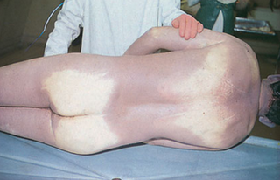

Slide 36
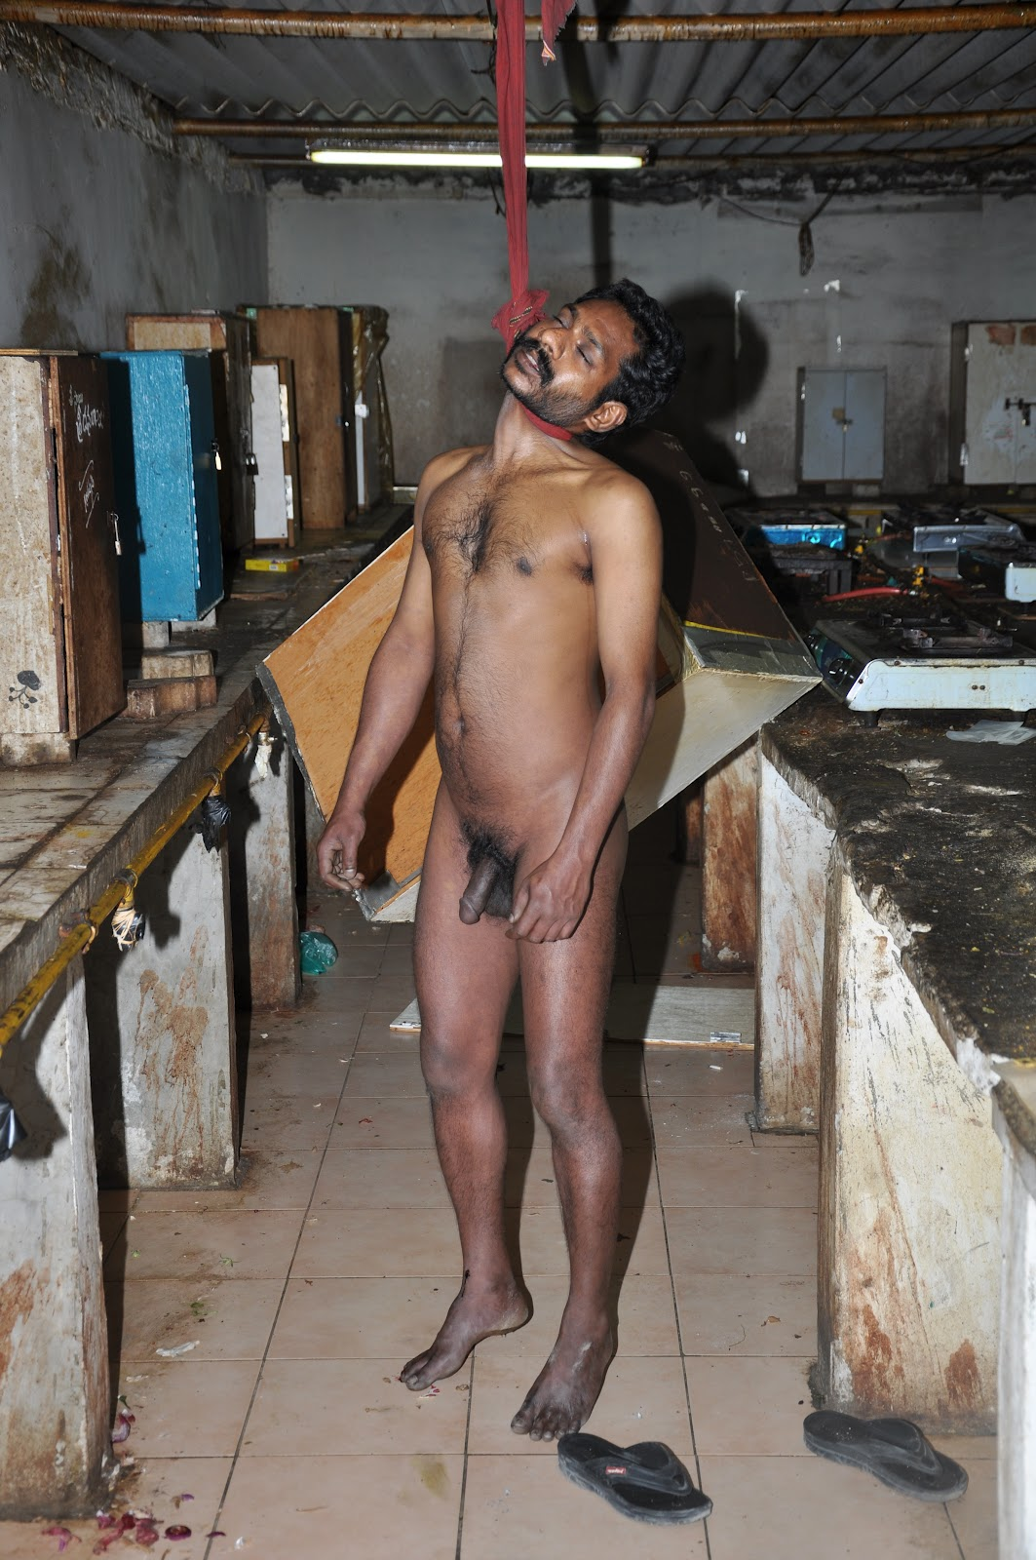

Slide 37
MUSCULAR CHANGES
3 stages :-
Primary relaxation or flaccidity.
Rigor mortis or cadaveric rigidity.
Secondary flaccidity.
Primary flaccidity :- 1 – 2 hours.
Death is only somatic.
All muscles relax soon after death, due to high ATP content splitting actin-myosin cross bridges.
Contact flattening is seen.

Slide 38
RIGOR MORTIS
Also called death stiffening or cadaveric rigidity.
It is stiffening of muscles, sometimes with shortening of muscle fibres. Individual cell death takes place.
Mechanism = reduction of ATP due to absence of its resynthesis.
Order of appearance =
Involuntary muscles (heart myocardium) = 1 hour.
Eyelids – neck – lower jaw – muscles of face – muscles of chest – upper limbs – abdomen – lower limbs – .

Slide 39
According to SHAPIRO :- proximo-distal progression is more apparent than real, sequence is determined by the bulk and kind of muscle involved.
Time of onset :- in India it starts 1 – 2 hours after death, takes 1 – 2 hours to develop. All muscles are involved in around 8 – 12 hours.
Duration :- lasts for 24 – 48 hours in winter and 18 – 36 hours in summer. Begins to disappear after 12 hours.

Slide 40
Conditions affecting onset and duration :-
Age
Nature of death.
Muscular state.
Atmospheric conditions.
Medico – Legal importance :-
It is a sign of death.
Helps in estimating time since death.
Indicates position of body at time of death.

Slide 41
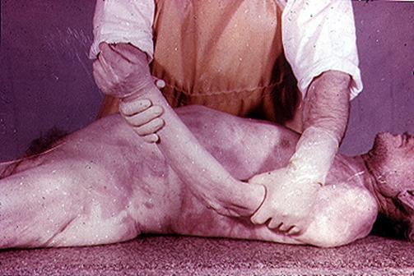

Slide 42
Conditions simulating rigor mortis :-
Heat stiffening – denaturation & coagulation of proteins = 65deg.
Cold stiffening – solidification of subcutaneous fat = -5 deg cel
Cadaveric spasm (instantaneous rigor).
Secondary relaxation :- flaccidity following rigor mortis, caused by action of alkaline liquid produced by putrefaction or solution of myosin by excess acid produced during rigor mortis. Or – autodigestion of myosin by enzymes produced in dead muscle.

Slide 43
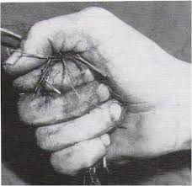

Slide 44
DECOMPOSITION
Involves 2 processes :-
Autolysis – self digestion of tissues.
Putrefaction – disintegration of body tissues after death.
Occurs after disappearance of rigor mortis.
Mechanism = fall in oxygen concentration and increase in hydrogen ion concentration favours growth of bacteria causing putrefactive changes.
Involves 3 main features :-
1) change in colour of tissues – 24 -36 hrs
2) evolution of gases in tissues – 36 – 72 hrs
3) liquefaction of tissues – 3 – 5 days

Slide 45
Internal phenomenon :-
Organs show putrefaction in the following order =
Larynx and trachea = 12 -24 hours
Stomach, intestines, pancreas and spleen (2 -3days) = 24 – 36 hrs.
Liver, lungs = 12 -24 hours.
Brain.
Heart.
Kidneys, bladder.
Prostate, uterus.
Skin, muscle, tendon.
Bones.

Slide 46
Conditions affecting the rate of putrefaction :-
External =
Temperature
Moisture.
Air.
Clothing.
Manner of burial.
b) Internal =
Age
Sex
Condition of the body
Cause of death.
Mutilation.

Slide 47
Putrefaction in water :-
Caspers dictum = body decomposes in air twice faster than in water, and 8 times as rapid as in earth.
Skeletonisation :- depends on =
Ambient temperature
Insect colonisation on the body.
Scavenger activity.
Seasonal and climatic variations.
Place of burial.
Uncoffined = 1 – 2 years.

Slide 48
ADIPOCERE (saponification)
Modification of putrefaction.
Fatty tissues of body change into substance known as adipocere.
Seen in bodies immersed in water or in damp, warm environment.
Mechanism = gradual hydrolysis and hydrogenation of pre-existing fats – which combine with calcium and ammonium ions to form insoluble soaps, inhibiting bacteria.
Forms at any site where fat is present. Face – buttocks – breasts – abdomen are usual sites.

Slide 49
Time required = variable.
- Begins in 4 – 5 days.
3 weeks in summer.
Stiffening, hardening and swelling of fats occurs over months.
Complete conversion in an adult limb – 3 – 6 months.
May persist for years or decades.
Medico – Legal importance :-
Helps to establish the identity.
Cause of death can be determined.
Time since death can be estimated.

Slide 50
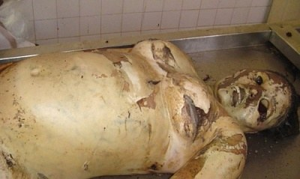

Slide 51
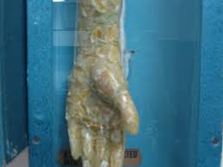

Slide 52
MUMMIFICATION
Modification of putrefaction.
Dehydration or drying and shriveling of cadaver due to evaporation of water, but the natural appearances of the body and facial features are preserved.
Begins in exposed parts of body like face, hands and feet and spreads to involve entire body including internal organs.
60 – 70 % of weight is lost and body becomes thin, stiff and brittle, and brown in colour. Internal organs become sunken, hard, dark brown or black single mass.

Slide 53
If not preserved properly the mummified body breaks into fragments gradually, becomes powdery and disintegrates. If protected can be preserved for years.
Factors necessary for mummification :-
Absence of moisture in air.
Continuous action of dry or warmed air.
Newborn babies are mummified if left in a cupboard or trunk, where atmosphere is warm and dry.
Chronic arsenic or antimony poisoning favours the process.

Slide 54
Differential decomposition :- at times body shows mummification in some parts and adipocere in other.
Time required for complete mummification varies between 3 months – 1 year.
Influenced by size of the body, atmospheric conditions and place of disposal.
Medico – Legal importance :-
Identity.
Cause of death.
Time since death.

Slide 55
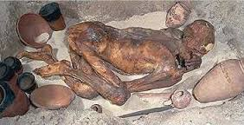

Slide 56
PRESERVATION OF BODY
Embalming.
Mummification
Adipocere formation.
Freezing.
Bodies present in water or soil containing antiseptic substances.
Injection of solution of arsenic, lead sulphide and potassium carbonate into femoral artery or aorta – for dissection.

Slide 57
ESTIMATION OF POSTMORTEM INTERVAL
Points to be noted are :-
Cooling of the body.
Post mortem lividity.
Rigor mortis.
Progress of decomposition, adipocere and mummification.
Entomology of cadaver :- study of form and behaviour of insects. Myiasis is infestation of body by fly maggots. Flies lay eggs in natural orifices and wounds over the body within minutes after death.
8 – 24 hours = larvae or maggots crawl out of eggs.
3 – 6 days = larvae become pupae.
6 – 10 days = pupae becomes adult.

Slide 58
6) GI Tract.
7) Cerebrospinal fluid :- cisternal fluid is examined. Changes in csf electrolytes are due to hypoxic damage of choroid plexus. Potassium increases in relation to temperature of body in 1st 20 hours.
8) Blood :-
lactic acid = increases by 50 -75 fold in 12 – 24 hours, peaking around 6 -8 hours.
Amino acid nitrogen = less than 14 mg/dl up to 10 hours, rises to 30 mg/dl by 48 hours.
Acid phosphatase = increases 20 times by 48 hours.
Amylase = increases 3 – 4 times on 2nd day.
Sodium = falls by 0.9 mEq/L per hour.
Organic Phosphorous in serum = 20 mEq/L at 18 hours.

Slide 59
9) Pericardial fluid.
10) Synovial fluid :- linear rise o potassium, more than double in first 2 days after death.
11) Vitreous humour :- potassium level is 5 – 8 mmol/l at time of death. It rises 0.17 – 0.24 mmol per hour. PMI=5.26 * K conc – 30.9. linear relation for 120 hours.
Vitreous glucose > 11.1 indicates diabetes, and < 1.4 mmol/l indicates hypoglycemia. Glucose reaches 0 within few hours after death.
12) Muscle enzymes :- myofibrillar protease activity increases linearly and CPK decreases linearly after death.
13) Hair and nails :- beard hair grows at 0.4 mm/day and nails at o.1 mm/day.
14) The scene of death.

Slide 60
Importance of post mortem interval =
To know when crime was committed.
To give police a starting point for enquiries.
Enables to exclude some suspects and search for likely suspects.
To confirm or disprove an alibi.
To check on suspects statements.
In civil cases – helps determine who inherits the property, insurance policy was in force or not.
* EXACT TIME OF DEATH CANNOT BE FIXED BY ANY METHOD, ONLY APPROXIMATE RANGE OF TIME OF DEATH CAN BE GIVEN.

Slide 61
THANK YOU & HAVE A GREAT DAY

