Slide 1

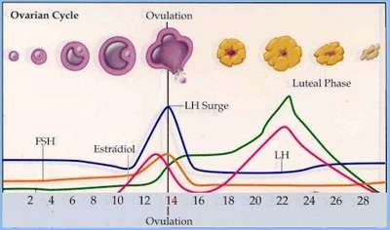
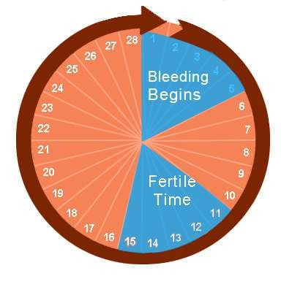
Physiology of Menstrual Cycle
Dr Sanjaykumar Patil

Slide 2
NORMAL MENSTRUAL CYCLE
mean duration of the MC
Mean 28 days (only 15% of )
Range 21-35
average duration of menses 3-8 days
normal estimated blood loss Approximately 30 ml
ovulation occur
Usually day 14
36 hrs after the onset of mid-cycle LH surge

Slide 3
NORMAL MENSTRUAL CYCLE
the phases of the MC & ovulation regulates by:
Interaction between hypothalamus, pituitary & ovaries
mean age of menarche & menopause are: Menarche 12.7
Menopause 51.4

Slide 4
The Cycle
Strongly linked to the endocrine system (hormone based and paracrine based)
Typically takes 28 days to cycle through 4 phases
  Follicular
  Ovulation
  Luteal
  Menstruation
Hormones raise and fall

Slide 5
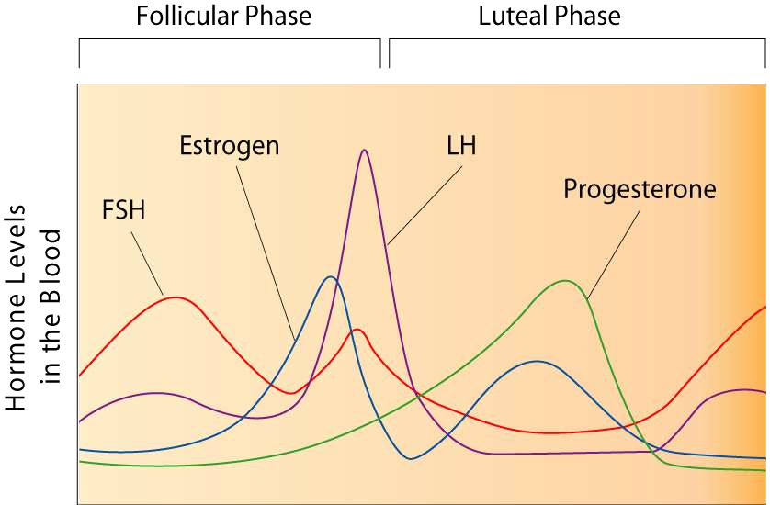
Ovulation

Slide 6
Follicular
Begins when estrogen levels are low
Anterior pituitary secretes FSH and LH, stimulation follicle to develop
Cells around egg enlarge, releasing estrogen
This causes this uterine lining to thicken

Slide 7
Ovulation
LH and FSH still being released, for another 3-4 days
Follicle ruptures, releasing ova into the Fallopian tubes

Slide 8
Luteal
Now empty follicle changes to a yellow colour, becomes corpus luteum
Continues to secrete estrogen, but now beings to release progesterone
Progesterone further develops uterine lining
If pregnant, embryo will release hormones to preserve corpus luteum

Slide 9
Menstruation
Menstruation
If no embryo, the corpus luteum begins to disintegrate
Progesterone levels drop, uterine lining detaches, menstruation can begin
Tissue, blood, unfertilized egg all discharged
Can take from 3-7 days

Slide 10
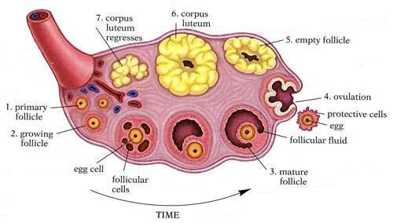

Slide 11
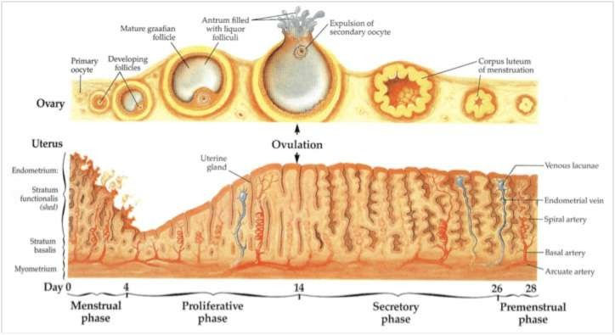

Slide 12
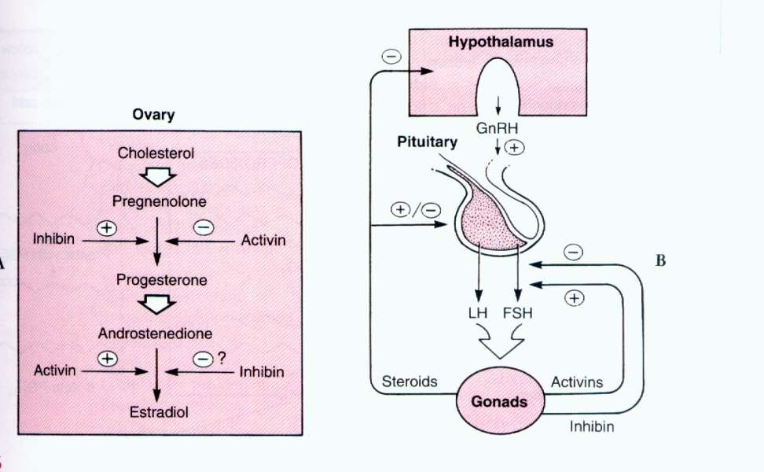
HYPOTHALAMIC- PITUITARY- OVARIAN AXIS

Slide 13
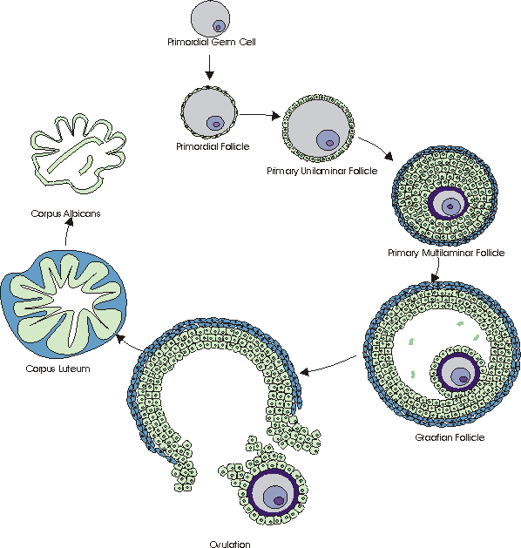
prof. aj

Slide 14
PHYSIOLOGYOF THE MENSTRUAL CYCLE
Ovulation divides the MC into two phases:
1-FOLLICULAR PHASE
-Begins with menses on day 1 of the menstrual cycle
& ends with ovulation
RECRUITMENT
FSH  maturation of a cohort of ovarian follicles “recruitment”
 only one reaches maturity

Slide 15
FOLLICULAR PHASE
MATURATION OF THE FOLLICLE (FOLLICULOGENESIS)
FSH  primordial follicle
(oocyte arrested in the diplotene stage of the 1st meiotic division surrounded by a single layer of granulosa cells)
  Primary follicle
(oocyte surrounded by a single layer of granulosa cells basement membrane & thica cells)
  Secondary follicle or preantral follicle
(oocyte surrounded by zona pellucida , several layers of granulosa cells & theca cells)

Slide 16
FOLLICULOGENESIS (2)
 tertiary or antral follicle
secondary follicle accumulate fluid in a cavity
“antrum”
oocyte is in eccentric position surrounded by granulosa cells “cumulous
oophorus”

Slide 17
FOLLICULOGENESIS (2)
SELECTION
Selection of the dominant follicle occurs day 5-7 It depends on
- the intrinsic capacity of the follicle to synthesize estrogen
-highest/and ratio in the follicular fluid As the follicle mature   estrogen  FSH
“-ve feed back on the pituitary”  the follicle with the highest no: of FSH receptors will continue to thrive
The other follicles “that were recruited” will become atretic

Slide 18
FSH ACTIONS
-recruitement
-mitogenic effect   No. of granulosa cells
 FSH receptor
-stimulates aromatase activity  conversion of androgens  estrogens “estrone & estradiol”
 LH receptors
ESTROGEN
Acts synergistically with FSH to
  induce LH receptors
  induce FSH receptors in granulosa & thica cells
LH  theca cells  uptake of cholesterol & LDL 
androstenedione & testosterone

Slide 19
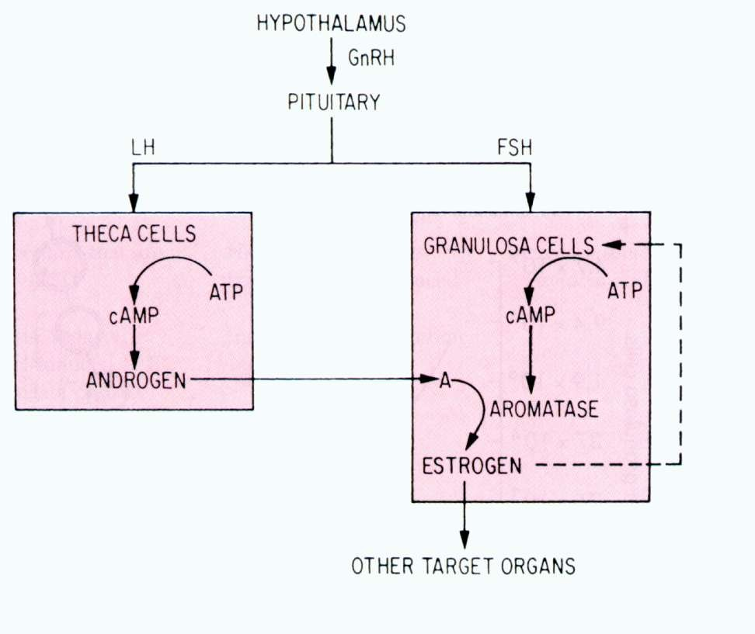
TWO CELL THEORY

Slide 20
FOLLICULOGENESIS (3)
OTHER FACTORS THAT PLAY A ROLE IN FOLLICULOGENISIS
-INHIBIN
Local peptide in the follicular fluid
-ve feed back on pituitary FSH secreation
Locally enhances LH-induced androstenedione production
-ACTIVIN
Found in follicular fluid
Stimulates FSH induced estrogen production
 gonadotropin receptors
androgen
No real stimulation of FSH secretion in vivo (bound to protein in serum)

Slide 21
PREOVULATORY PERIOD
NEGATIVE FEEDBACK ON THE PIUITARY
- estradiol & inhibin -ve feed back on pituitary   FSH
-This mechanism operating since childhood
POSITIVE FEEDBACK ON THE PITUITARY
  estradiol (reaching a threshold concentration)   +ve feed back on the pituitary (facilitated by low levels of progestrone)   LH surge  secretion of progestrone
Operates after puberty
• +ve feed back on pituitary   FSH

Slide 22
PREOVULATORY PERIOD
LH SURGE
Lasts for 48 hrs
Ovulation occurs after 36 hrs
Accompanied by rapid fall in estradiol level
Triggers the resumption of meiosis
Affects follicular wall  follicular rupture
Granulosa cells  lutenization  progestrone synthesis

Slide 23
OVULATION
The dominant follicle protrudes from the ovarian cortex
Gentle release of the oocyte surrounded by the cumulus granulosa cells
Mechanism of follicular rupture
1- Follicular pressure
Changes in composition of the antral fluid   colloid osmotic pressure
2-Enzymatic rupture of the follicular wall
LH & FSH  granulosa cells  production of plasminogen activator
  plasmin   fibrinolytic activity  breake down of F. wall LH   prostglandin E   plasminogen activator
  PG F2α   lysosomes under follicular wall

Slide 24
LUTEAL PHASE
LASTS 14 days
FORMATION OF THE CORPUS LUTEUM
After ovulation the point of rupture in the follicular wall seals
Vascular capillaries cross the basement membrane & grow into the granulosa cells  availability of LDL-cholestrole
LH  LDL binding to receptors
 3α OH steroid dehydrogenase activity
 progestrone

Slide 25
LUTEAL PHASE
Marked  in progestrone secretion
Progestrone actions:
-suppress follicular maturation on the ipsilateral ovary
-thermogenic activity  basal body
temp
-endometrial maturation
Progestrone peak 8 days after ovulation (D22 MC)
Corpus luteum is sustained by LH
It looses its sensitivity to gonadotropins 
luteolysis 
estrogen & progestrone level  desquamation of the endometrium “menses”

Slide 26
LUTEAL PHASE
estrogen & progestrone   FSH &LH
The new cycle stars with the beginning of menses
If pregnancy occurs  hCG secreation  maintain the corpus luteum

Slide 27
ENDOMETRIAL CHANGES DURING THE MENSTRUAL CYCLE
Basal layer of the endometrium
-Adjacent to the myometrium
-Unresponsive to hormonal stimulation
-Remains intact throughout the menstrual cycle
Functional layer of the endometrium Composed of two layers:
-zona compacta  superficial
-Spongiosum layer

Slide 28
ENDOMETRIAL CHANGES DURING THE MENSTRUAL CYCLE
Follicular /proliferative phase
Estrogen  mitotic activity in the glands & stroma 
 enometrial thickness from 2 to 8 mm (from basalis to opposed basalis layer)
Luteal /secretory phase
Progestrone - Mitotic activity is severely restricted
-Endometrial glands produce then secrete
glycogen rich vacoules
-Stromal edema
-Stromal cells enlargement
-Spiral arterioles develop, lengthen & coil

Slide 29
MENSTRUATION
Periodic desquamation of the endometrium
The external hallmark of the menstrual cycle
Just before menses the endometrium is infiltrated with leucocytes
Prostaglandins are maximal in the endometrium just before menses
Prostaglandins  constriction of the spiral arterioles
ischemia & desquamation
Followed by arteriolar relaxation, bleeding & tissue breakdown

Slide 30
HYPOTHALAMIC ROLE IN THE MENSTRUAL CYCLE
The hypothalamus secretes GnRH in a pulsatile fashion
GnRH activity is first evident at puberty
Follicular phase GnRH pulses occur hourly
Luteal phase GnRH pulses occur every 90 minutes
Loss of pulsatility down regulation of pituitary receptors  
secretion of gonadotropins
Release of GnRH is modulated by –ve feedback by: steroids
gonadotropins
Release of GnRH is modulated by external neural signals

Slide 31


THANKYOU
Education’s purpose is to replace an empty mind with an open one”
~ Malcolm Forbes

